Slide 1

Customer Churn
Prediction

Slide 2

Team Members
Mentors
Kunal Mallick
Karthik Sir
Ajay Anap
Abhishek Bhonde
Dhanyapriya Ma’am
Parvati Tambe
Harsh Dalal
Sandeep Murud
Nabeel Siddiqui

Slide 3

Objective
Customer churn is a big problem for telecommunications companies. Indeed, their annual churn rates are usually higher than 10%. For that reason, they develop strategies to keep as many clients as possible. This is a classification project since the variable to be predicted is binary (churn or loyal customer). The goal here is to model churn probability, conditioned on the customer features.

Slide 4
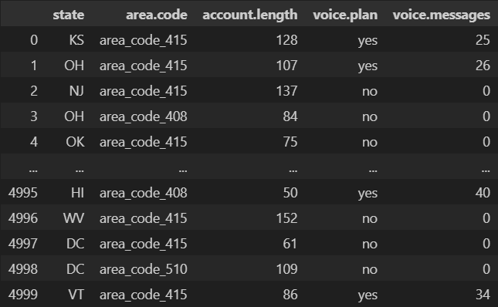
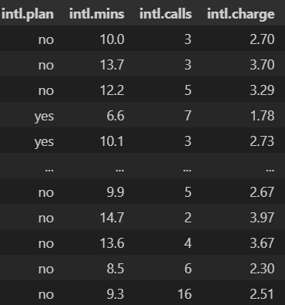
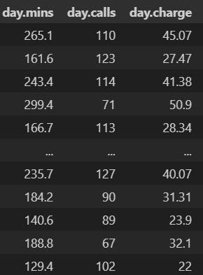
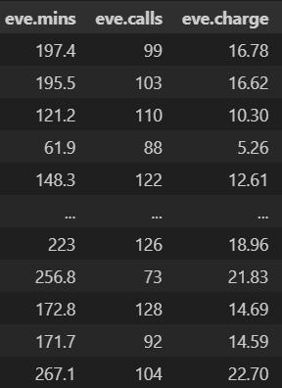
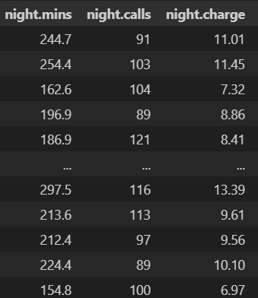
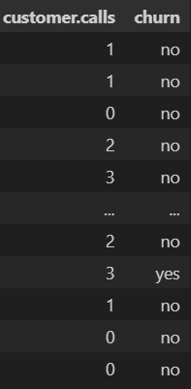
Loading The Datasets

Slide 5


Slide 6
Data Description
state: Categorical, for the 51 states and the District of Columbia.
Area.code
account.length: how long the account has been active.
voice.plan: yes or no, voicemail plan.
voice.messages: number of voicemail messages.
intl.plan: yes or no, international plan.
intl.mins: minutes customer used service to make international calls.
intl.calls: total number of international calls.
intl.charge: total international charge.
day.mins: minutes customer used service during the day.
day.calls: total number of calls during the day.
day.charge: total charge during the day.
eve.mins: minutes customer used service during the evening.
eve.calls: total number of calls during the evening.
eve.charge: total charge during the evening.
night.mins: minutes customer used service during the night.
night.calls: total number of calls during the night.
night.charge: total charge during the night.
customer.calls: number of calls to customer service.
churn: Categorical, yes or no. Indicator of whether the customer has left the company (yes or no).

Slide 7
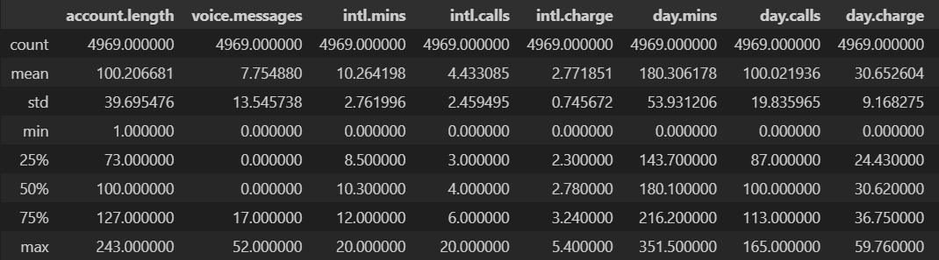
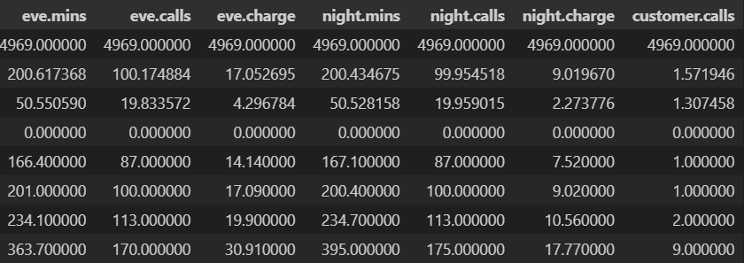
Running Describe

Slide 8
Running Info()
<class 'pandas.core.frame.DataFrame'>
RangeIndex: 5000 entries, 0 to 4999
Data columns (total 20 columns):
# Column Non-Null Count Dtype
-- ----------- ----------------- --------
0 state 5000 non-null object
1 area.code 5000 non-null object
2 account.length 5000 non-null int64
3 voice.plan 5000 non-null object
4 voice.messages 5000 non-null int64
5 intl.plan 5000 non-null object
6 intl.mins 5000 non-null float64
7 intl.calls 5000 non-null int64
8 intl.charge 5000 non-null float64
9 day.mins 5000 non-null float64
10 day.calls 5000 non-null int64
11 day.charge 5000 non-null object
12 eve.mins 5000 non-null object
13 eve.calls 5000 non-null int64
14 eve.charge 5000 non-null float64
15 night.mins 5000 non-null float64
16 night.calls 5000 non-null int64
17 night.charge 5000 non-null float64
18 customer.calls 5000 non-null int64
19 churn 5000 non-null object
dtypes: float64(6), int64(7), object(7)
memory usage: 781.4+ KB

Slide 9
Missing Value Imputation
state has 0 % missing value(0)
area.code has 0 % missing value(0)
account.length has 0 % missing value(0)
voice.plan has 0 % missing value(0)
voice.messages has 0 % missing value(0)
intl.plan has 0 % missing value(0)
intl.mins has 0 % missing value(0)
intl.calls has 0 % missing value(0)
intl.charge has 0 % missing value(0)
day.mins has 0 % missing value(0)
day.calls has 0 % missing value(0)
day.charge has 0 % missing value(0)
eve.mins has 0 % missing value(0)
eve.calls has 0 % missing value(0)
eve.charge has 0 % missing value(0)
night.mins has 0 % missing value(0)
night.calls has 0 % missing value(0)
night.charge has 0 % missing value(0)
customer.calls has 0 % missing value(0)
churn has 0 % missing value(0)

Slide 10
Finding Unique Values In Dataset
area.code
All Unique Value in area.code
['area_code_408' 'area_code_415' 'area_code_510']
Total no of unique values 3
state
All Unique Value in state
['AK' 'AL' 'AR' 'AZ' 'CA' 'CO' 'CT' 'DC' 'DE' 'FL' 'GA' 'HI' 'IA' 'ID'
'IL' 'IN' 'KS' 'KY' 'LA' 'MA' 'MD' 'ME' 'MI' 'MN' 'MO' 'MS' 'MT' 'NC'
'ND' 'NE' 'NH' 'NJ' 'NM' 'NV' 'NY' 'OH' 'OK' 'OR' 'PA' 'RI' 'SC' 'SD'
'TN' 'TX' 'UT' 'VA' 'VT' 'WA' 'WI' 'WV' 'WY']
Total no of unique values 51

Slide 11
area.length
All Unique Value in account.length
[ 1 2 3 4 5 6 7 8 9 10 11 12 13 14 15 16 17 18
19 20 21 22 23 24 25 26 27 28 29 30 31 32 33 34 35 36
37 38 39 40 41 42 43 44 45 46 47 48 49 50 51 52 53 54
55 56 57 58 59 60 61 62 63 64 65 66 67 68 69 70 71 72
73 74 75 76 77 78 79 80 81 82 83 84 85 86 87 88 89 90
91 92 93 94 95 96 97 98 99 100 101 102 103 104 105 106 107 108
109 110 111 112 113 114 115 116 117 118 119 120 121 122 123 124 125 126
127 128 129 130 131 132 133 134 135 136 137 138 139 140 141 142 143 144
145 146 147 148 149 150 151 152 153 154 155 156 157 158 159 160 161 162
163 164 165 166 167 168 169 170 171 172 173 174 175 176 177 178 179 180
181 182 183 184 185 186 187 188 189 190 191 192 193 194 195 196 197 199
200 201 202 204 205 208 209 210 212 215 216 217 221 222 224 225 232 233
238 243]
Total no of unique values 218
voice.plan
All Unique Value in voice.plan
['no' 'yes']
Total no of unique values 2

Slide 12
area.length
All Unique Value in account.length
[ 1 2 3 4 5 6 7 8 9 10 11 12 13 14 15 16 17 18
19 20 21 22 23 24 25 26 27 28 29 30 31 32 33 34 35 36
37 38 39 40 41 42 43 44 45 46 47 48 49 50 51 52 53 54
55 56 57 58 59 60 61 62 63 64 65 66 67 68 69 70 71 72
73 74 75 76 77 78 79 80 81 82 83 84 85 86 87 88 89 90
91 92 93 94 95 96 97 98 99 100 101 102 103 104 105 106 107 108
109 110 111 112 113 114 115 116 117 118 119 120 121 122 123 124 125 126
127 128 129 130 131 132 133 134 135 136 137 138 139 140 141 142 143 144
145 146 147 148 149 150 151 152 153 154 155 156 157 158 159 160 161 162
163 164 165 166 167 168 169 170 171 172 173 174 175 176 177 178 179 180
181 182 183 184 185 186 187 188 189 190 191 192 193 194 195 196 197 199
200 201 202 204 205 208 209 210 212 215 216 217 221 222 224 225 232 233
238 243]
Total no of unique values 218
voice.messages
voice.plan
All Unique Value in voice.messages
[ 0 4 6 8 9 10 11 12 13 14 15 16 17 18 19 20 21 22 23 24 25 26 27 28
29 30 31 32 33 34 35 36 37 38 39 40 41 42 43 44 45 46 47 48 49 50 51 52]
Total no of unique values 48
All Unique Value in voice.plan
['no' 'yes']
Total no of unique values 2

Slide 13
intl.plan
All Unique Value in intl.plan
['no' 'yes']
Total no of unique values 2
intl.mins
All Unique Value in intl.mins
[ 0. 0.4 1.1 1.3 2. 2.1 2.2 2.4 2.5 2.6 2.7 2.9 3.1 3.3
3.4 3.5 3.6 3.7 3.8 3.9 4. 4.1 4.2 4.3 4.4 4.5 4.6 4.7
4.8 4.9 5. 5.1 5.2 5.3 5.4 5.5 5.6 5.7 5.8 5.9 6. 6.1
6.2 6.3 6.4 6.5 6.6 6.7 6.8 6.9 7. 7.1 7.2 7.3 7.4 7.5
7.6 7.7 7.8 7.9 8. 8.1 8.2 8.3 8.4 8.5 8.6 8.7 8.8 8.9
9. 9.1 9.2 9.3 9.4 9.5 9.6 9.7 9.8 9.9 10. 10.1 10.2 10.3
10.4 10.5 10.6 10.7 10.8 10.9 11. 11.1 11.2 11.3 11.4 11.5 11.6 11.7
11.8 11.9 12. 12.1 12.2 12.3 12.4 12.5 12.6 12.7 12.8 12.9 13. 13.1
13.2 13.3 13.4 13.5 13.6 13.7 13.8 13.9 14. 14.1 14.2 14.3 14.4 14.5
14.6 14.7 14.8 14.9 15. 15.1 15.2 15.3 15.4 15.5 15.6 15.7 15.8 15.9
16. 16.1 16.2 16.3 16.4 16.5 16.6 16.7 16.8 16.9 17. 17.1 17.2 17.3
17.5 17.6 17.7 17.8 17.9 18. 18.2 18.3 18.4 18.5 18.7 18.9 19.2 19.3
19.7 20. ]
Total no of unique values 170

Slide 14
intl.calls
All Unique Value in intl.calls
[ 0 1 2 3 4 5 6 7 8 9 10 11 12 13 14 15 16 17 18 19 20]
Total no of unique values 21
intl.charge
All Unique Value in intl.charge
[0. 0.11 0.3 0.35 0.54 0.57 0.59 0.65 0.68 0.7 0.73 0.78 0.84 0.89
0.92 0.95 0.97 1. 1.03 1.05 1.08 1.11 1.13 1.16 1.19 1.22 1.24 1.27
1.3 1.32 1.35 1.38 1.4 1.43 1.46 1.49 1.51 1.54 1.57 1.59 1.62 1.65
1.67 1.7 1.73 1.76 1.78 1.81 1.84 1.86 1.89 1.92 1.94 1.97 2. 2.03
2.05 2.08 2.11 2.13 2.16 2.19 2.21 2.24 2.27 2.3 2.32 2.35 2.38 2.4
2.43 2.46 2.48 2.51 2.54 2.57 2.59 2.62 2.65 2.67 2.7 2.73 2.75 2.78
2.81 2.84 2.86 2.89 2.92 2.94 2.97 3. 3.02 3.05 3.08 3.11 3.13 3.16
3.19 3.21 3.24 3.27 3.29 3.32 3.35 3.38 3.4 3.43 3.46 3.48 3.51 3.54
3.56 3.59 3.62 3.65 3.67 3.7 3.73 3.75 3.78 3.81 3.83 3.86 3.89 3.92
3.94 3.97 4. 4.02 4.05 4.08 4.1 4.13 4.16 4.19 4.21 4.24 4.27 4.29
4.32 4.35 4.37 4.4 4.43 4.46 4.48 4.51 4.54 4.56 4.59 4.62 4.64 4.67
4.73 4.75 4.78 4.81 4.83 4.86 4.91 4.94 4.97 5. 5.05 5.1 5.18 5.21
5.32 5.4 ]
Total no of unique values 170

Slide 15
day.calls
All Unique Value in day.calls
[ 0 30 34 35 36 39 40 42 44 45 46 47 48 49 50 51 52 53
54 55 56 57 58 59 60 61 62 63 64 65 66 67 68 69 70 71
72 73 74 75 76 77 78 79 80 81 82 83 84 85 86 87 88 89
90 91 92 93 94 95 96 97 98 99 100 101 102 103 104 105 106 107
108 109 110 111 112 113 114 115 116 117 118 119 120 121 122 123 124 125
126 127 128 129 130 131 132 133 134 135 136 137 138 139 140 141 142 143
144 145 146 147 148 149 150 151 152 156 157 158 160 163 165]
Total no of unique values 123
day.mins
day.charge
All Unique Value in day.mins
[ 0. 2.6 6.6 ... 346.8 350.8 351.5]
Total no of unique values 1957
All Unique Value in day.charge
[ 0. 0.44 1.12 ... 58.96 59.64 59.76]
Total no of unique values 1957

Slide 16
eve.calls
All Unique Value in eve.calls
[ 0 12 36 37 38 42 43 44 45 46 47 48 49 50 51 52 53 54
55 56 57 58 59 60 61 62 63 64 65 66 67 68 69 70 71 72
73 74 75 76 77 78 79 80 81 82 83 84 85 86 87 88 89 90
91 92 93 94 95 96 97 98 99 100 101 102 103 104 105 106 107 108
109 110 111 112 113 114 115 116 117 118 119 120 121 122 123 124 125 126
127 128 129 130 131 132 133 134 135 136 137 138 139 140 141 142 143 144
145 146 147 148 149 150 151 152 153 154 155 156 157 159 164 168 169 170]
Total no of unique values 126
eve.mins
eve.charge
All Unique Value in eve.mins
[ 0. 22.3 31.2 ... 359.3 361.8 363.7]
Total no of unique values 1875
All Unique Value in eve.charge
[ 0. 1.9 2.65 ... 30.54 30.75 30.91]
Total no of unique values 1655

Slide 17
night.calls
All Unique Value in night.calls
[ 0 12 33 36 38 40 41 42 43 44 46 48 49 50 51 52 53 54
55 56 57 58 59 60 61 62 63 64 65 66 67 68 69 70 71 72
73 74 75 76 77 78 79 80 81 82 83 84 85 86 87 88 89 90
91 92 93 94 95 96 97 98 99 100 101 102 103 104 105 106 107 108
109 110 111 112 113 114 115 116 117 118 119 120 121 122 123 124 125 126
127 128 129 130 131 132 133 134 135 136 137 138 139 140 141 142 143 144
145 146 147 148 149 150 151 152 153 154 155 156 157 158 159 160 161 164
165 166 168 170 175]
Total no of unique values 131
night.mins
night.charge
All Unique Value in night.mins
[ 0. 23.2 43.7 ... 381.6 381.9 395. ]
Total no of unique values 1849
All Unique Value in night.charge
[ 0. 1.04 1.97 ... 17.17 17.19 17.77]
Total no of unique values 1028

Slide 18
customer.calls
All Unique Value in customer.calls
[0 1 2 3 4 5 6 7 8 9]
Total no of unique values 10
churn
All Unique Value in churn
['no' 'yes']
Total no of unique values 2

Slide 19
Data Cleaning
Droping All Nan Data
12, 27, 47, 89, 102, 110, 159, 231, 254, 299, 345, 460, 557, 624, 684, 729, 750, 795, 892, 1012, 1099, 1219, 1417, 1483, 1625,...
1778, 4407, 4755, 4965, 4992
lost_record
We lost 0.62 % data

Slide 20
Checking for Duplicated Values
There is no duplicate value in are dataset

Slide 21

Conclusion
As there are several categorical variables, we discovered that there will be an issue with the curse of dimensionality.
Our study shows that there are three unique area codes and 51 different states.
The dataset is broken down into 4 categories, including international, day, evening, and night, as well as 3 subcategories for minutes, calls, and costs.

Slide 22

Next Step
We'll start visualizing the data if all goes according to plan.
In order to visualize the distribution of churn, a pie plot will be constructed.
All four major categories will be shown in 2D or, if necessary, 3D.

